Slide 1


Neutrino Oscillation
June 08, 2023 NeutrinoNet
Yuan-Yen Peng, Siang-Yuan Lin
PHYS 591000 Hands-on Artificial Intelligence for Physics
National Tsing Hua University (NTHU)
Hsinchu, Taiwan

Slide 2
Outline
Recap of physics
Neutrino oscillation
Methodology and Results
Data description
Preprocessing and models
Other models
Conclusion and discussion
Summary
Backup
Supplementary materials
Notes:
Recap the oscillation physics.
Method we use and the results our main models.
Briefly summarize what we did in this project.

Slide 3
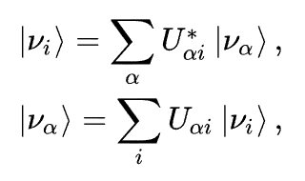
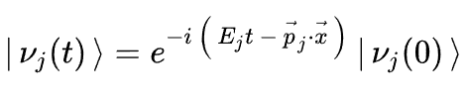
1.1 Neutrino Oscillation
Mass Eigenstates:
The eigenstates to the free Hamiltonian are mass eigenstates.
Flavor Eigenstates:
The eigenstates to the interaction Hamiltonian are flavor eigenstates.
Superposition:
The standard model neutrinos are theorized to be a superposition of mass eigenstates.
Time evolution:
A. Donini, M.B. Gavela, P. Hernández, S. Rigolin, Neutrino mixing and CP-violation, Nuclear Physics B. 574 (2000) 23–42.
Notes:
Mass: physics observed quantities
Flavor: states interact with the weak force
→ flavor states are the superposition of the mass states
Besides, because we are discuss about the neutrino oscillation, so the “time evolution” is the crucial part, too.

Slide 4
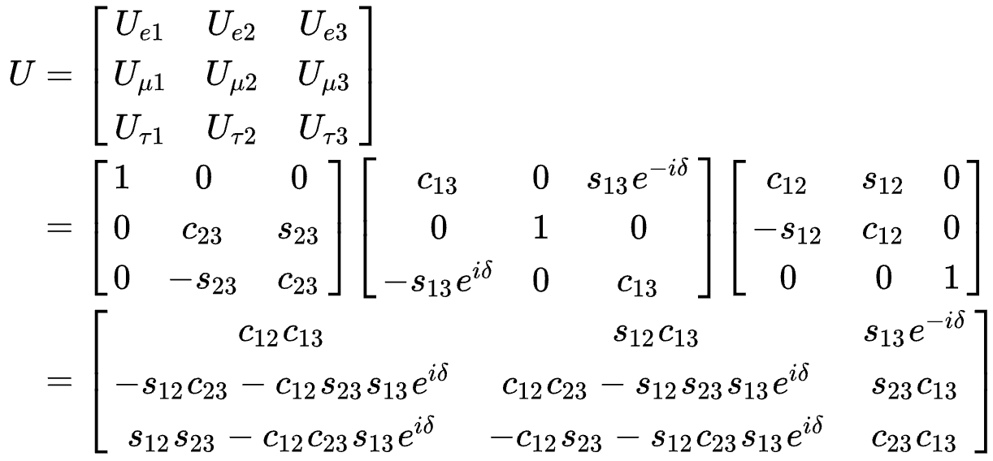
The Pontecorvo–Maki–Nakagawa–Sakata (PMNS) Matrix
The unitary transformation between the flavor and mass eigenstates can be determined with 4 parameters: θ₁₂, θ₁₃, θ₂₃, and δ_{CP}.
Notes:
The “U” matrix is the is a famous unitary matrix called the PMNS matrix.
It can be determined by the 4 parameters, <POINT>

Slide 5
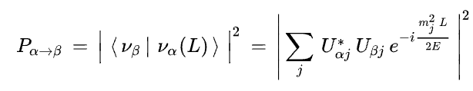
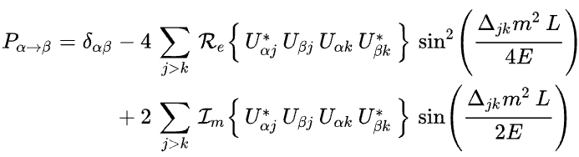
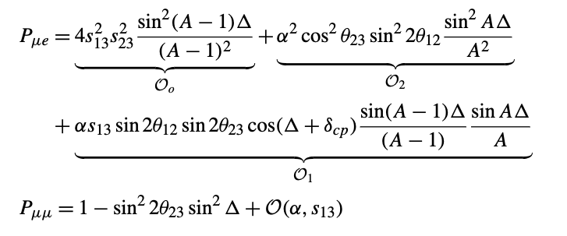
General form of the probability:
The main probability formulas we used:
N. Nath, M. Ghosh, and S. Goswami, The Physics of Antineutrinos in DUNE and Determination of Octant and δ_{CP}, Nuclear Physics B 913, 381 (2016).
Notes:
Upper is the general form of probabilities.
Below are the main formulas that we are going to use.

Slide 6

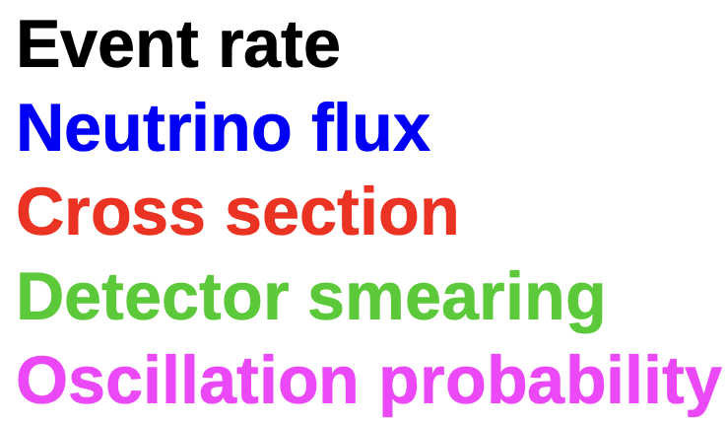
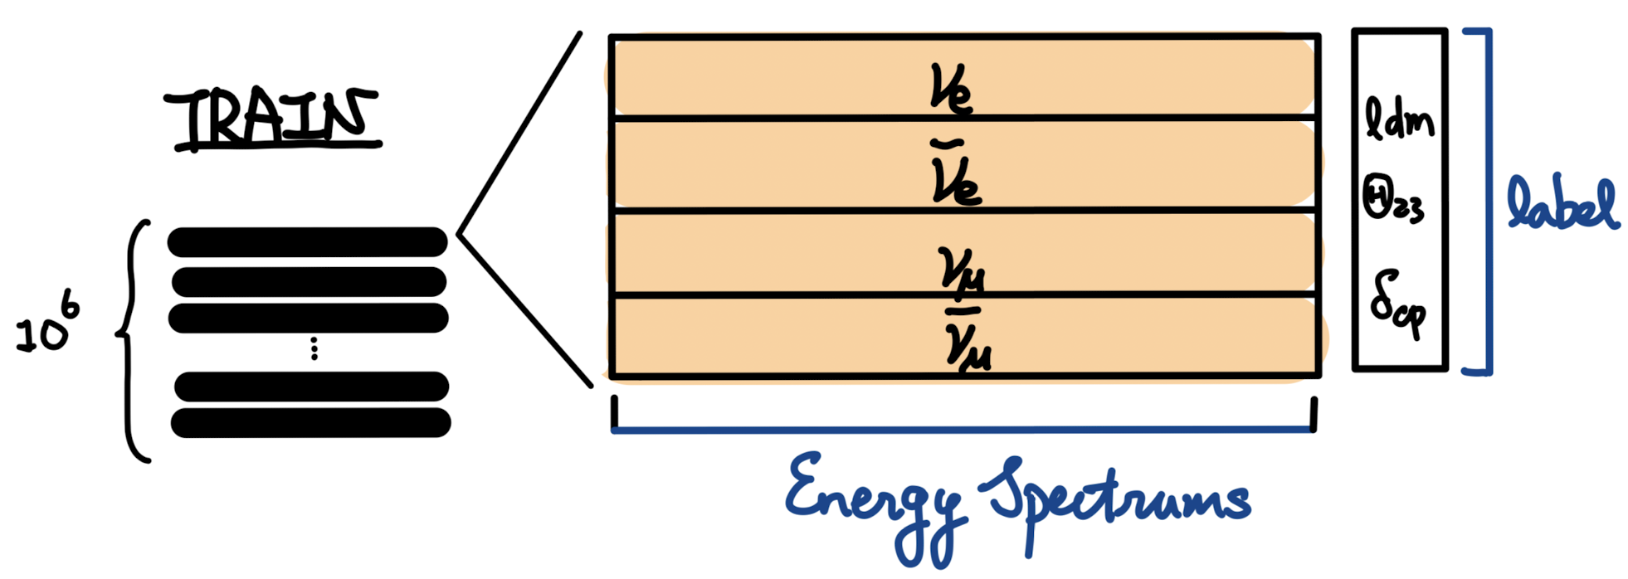
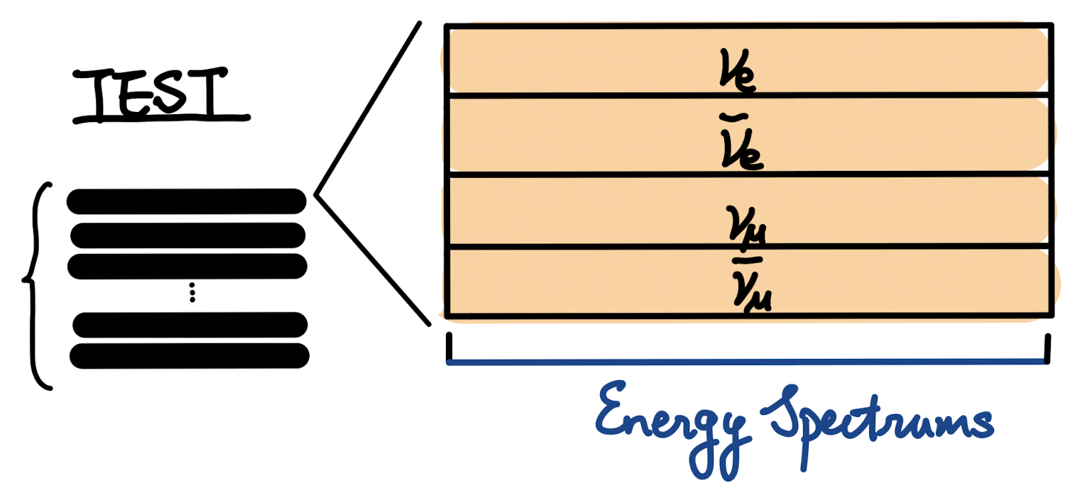
2.1 Data description
Data source: GLoBES simulation data.
1,000
Callum Wilkinson, Neutrino oscillation physics and cross sections
Notes:
Data source is from the globes, and you can find the details information is the hyperlink <here>
Globes simulate event rate, cross section, detector smearing. In this project we are going to do the analysis of <ANIME> flux, and the probability.
Our train sample is consist of 10 to power 6 data with the energy spectrum of 4 channels and the 3 labels <labels>; the differences in the test sample is that the test sample has the fluctuation and don’t have the labels.

Slide 7
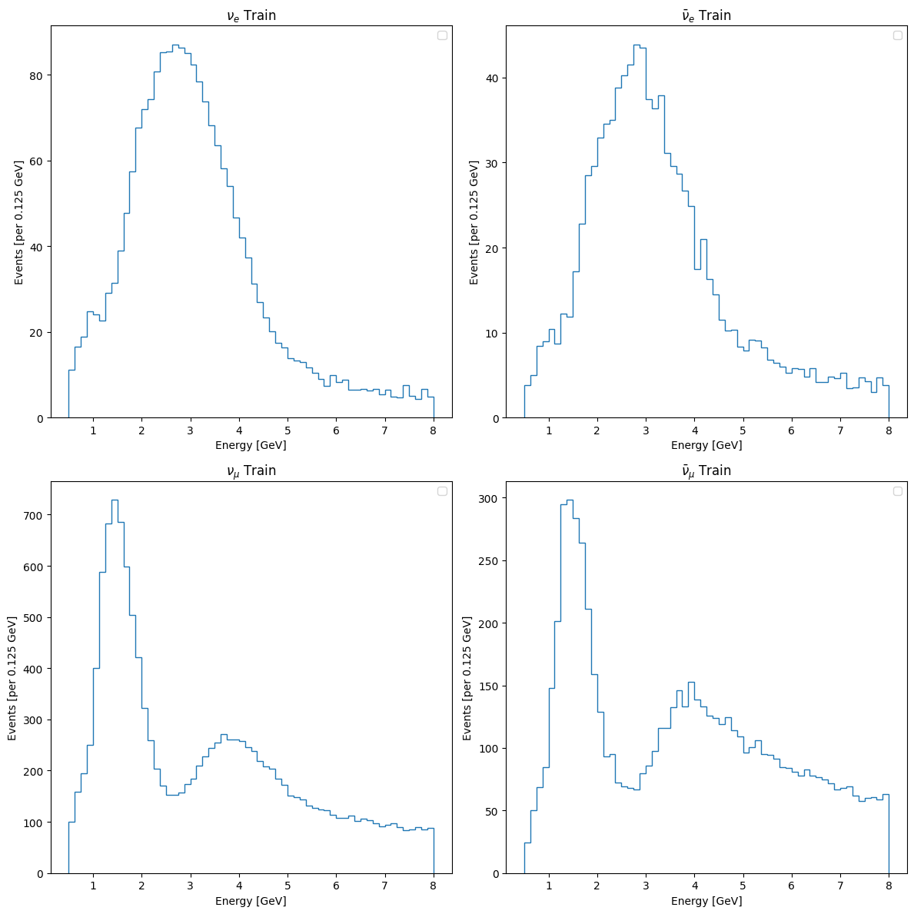
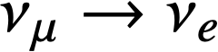
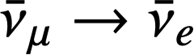
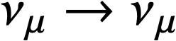
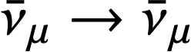
In this project we have 4 channels (2 appearances and 2 disappearances), and 3 labels (ldm, θ₂₃, δ_{CP} ).
Four channels
Appearance channels
Disappearance channels

Slide 8
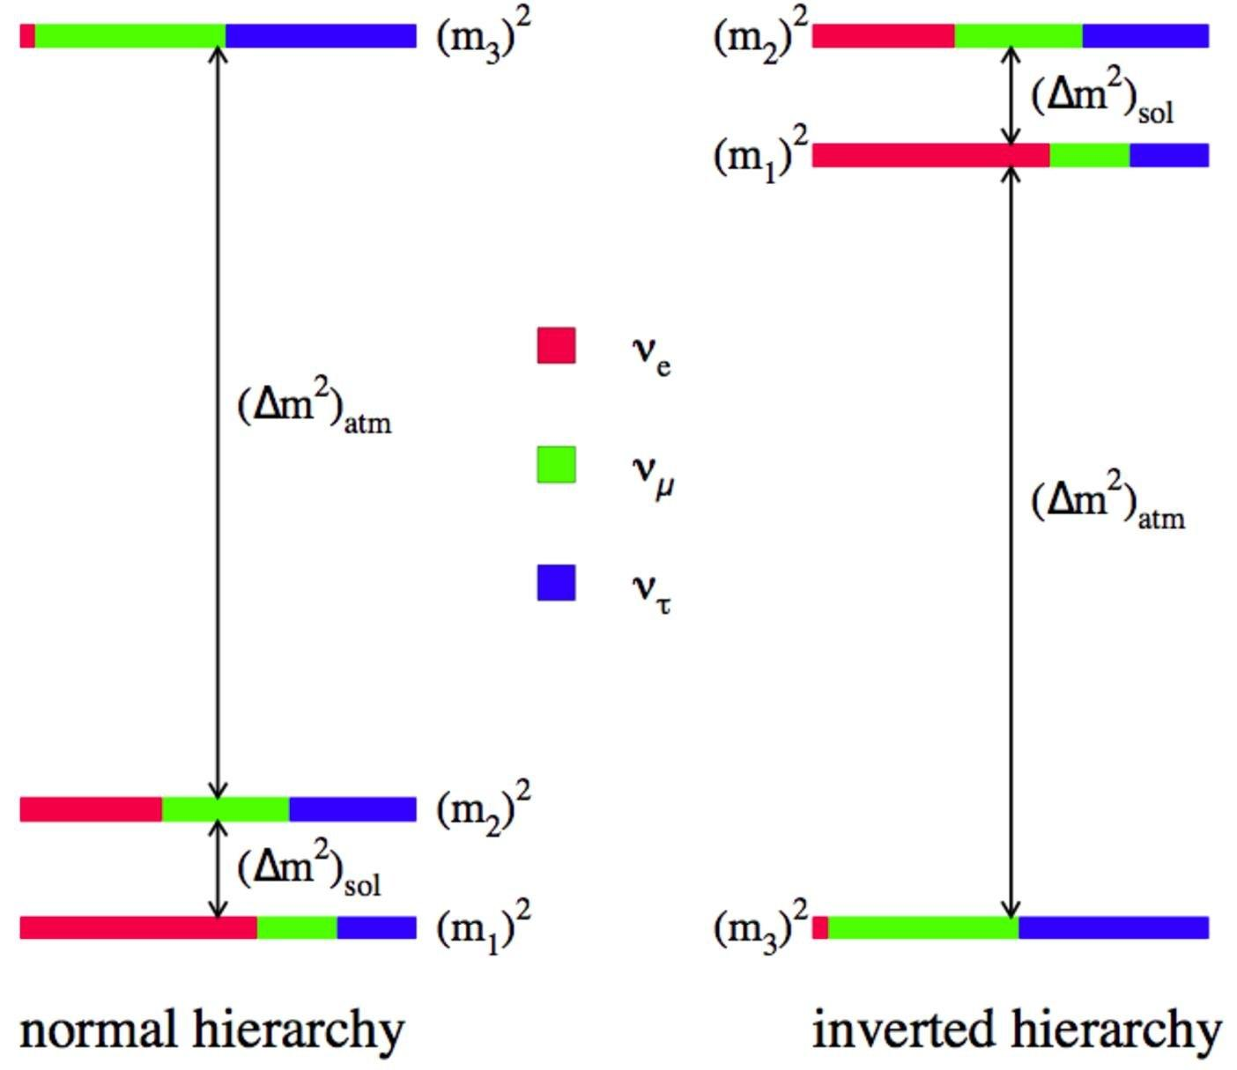
Mixing angle θ₂₃, and CP phase δ_{CP}
θ₂₃ ranges from approximately 39 to 51 degrees, δ_{CP} ranges from 0 to 360 degrees.
Mass hierarchy ldm
We are only able to know the difference and its orderings.
ldm only has two significant peaks, which tells us that we can split our train data into NO and IO two parts.
NO
IO

Slide 9
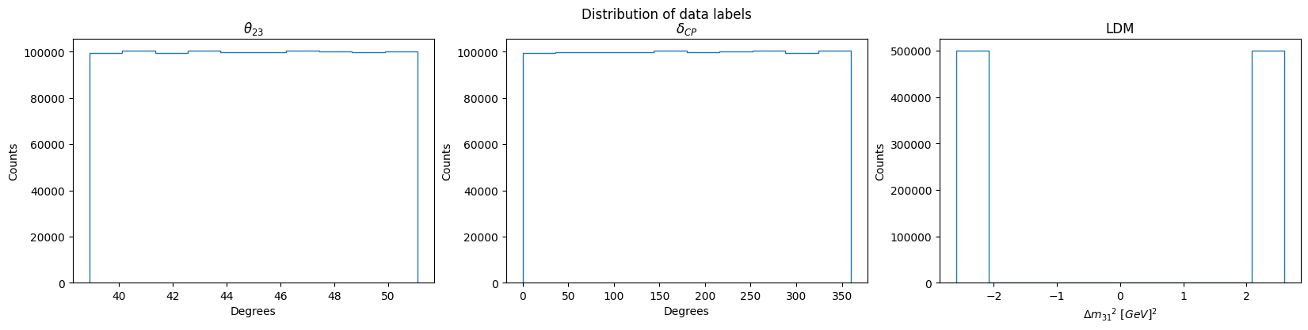
Separate data into two groups.
Tasked to find the correlation between 2 ANGLES and 4 SPECTRUMS.
Notes:
Here is the quick summary of the three labels.
<Theta>: from 31 to 51 degrees
<delta>: form 0 to 260 degrees
<ldm>: mass hierarchy discussed in the previous report, and it has two distinct two peaks.
So, we use these two peaks to separate the data into two groups, and <ANIME> use the energy spectrums to regress the Theta_23 and delta_cp.

Slide 10
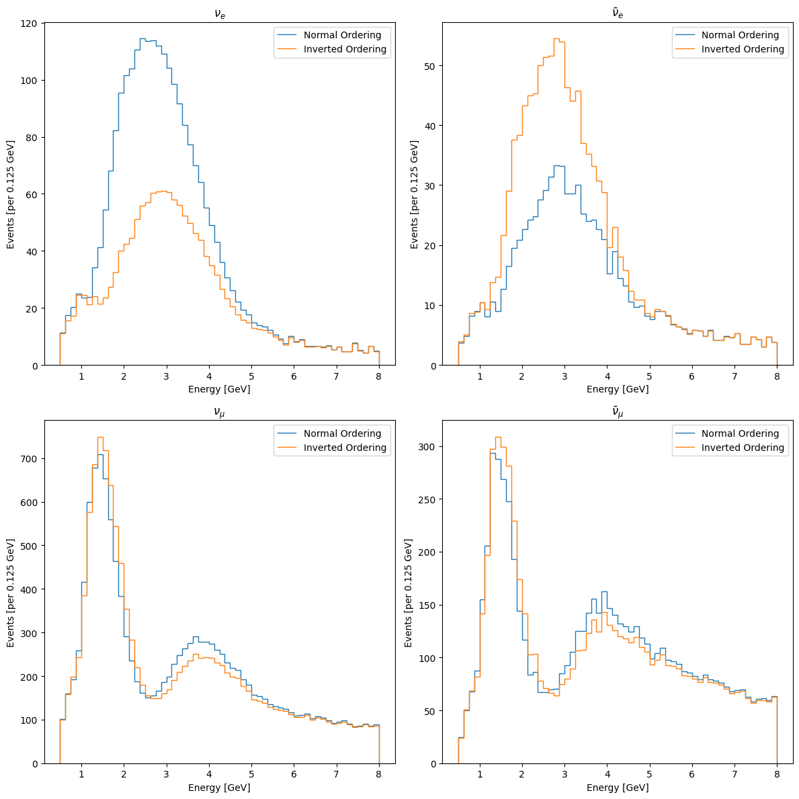
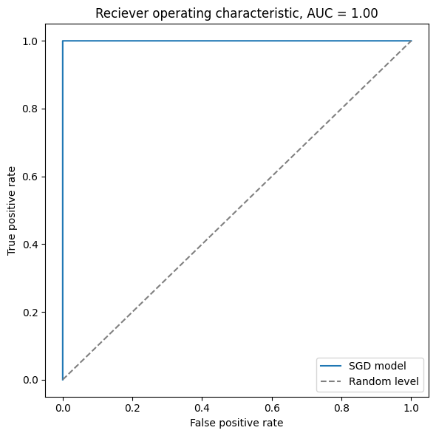
2.2 Preprocessing and models
I. LDM classification
Distinct difference in these distributions.
SVM with SGD → binary classification.
Perfect classificated!
⬆︎ averaged spectrum of the NO and IO
Notes:
This is our first model, LDM classification models. We can find that there are obvious differences between IO and NO. Therefore, we do the binary classification implementing and SVm with SGD classifier.
It shows that it is perfect classificated.

Slide 11
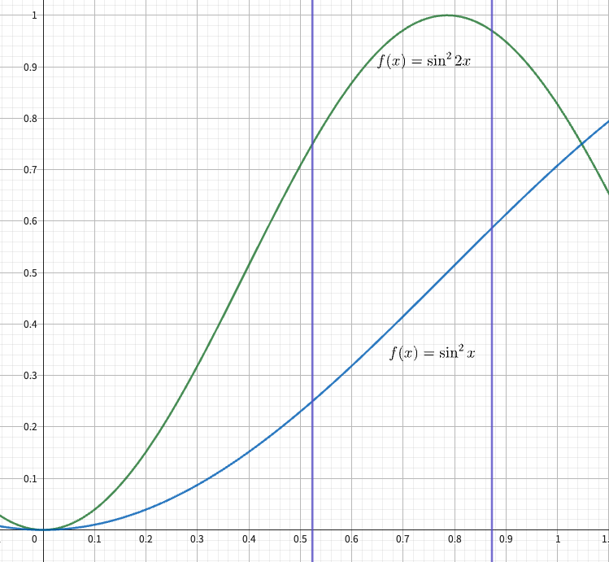
II. DCNN regression {θ₂₃}
Theoretically, θ₂₃ in (with non-trivial leading order):
appearance channel: ~ sin² θ₂₃
disappearance channel:~ sin² 2θ₂₃
In this interval (30 ~ 50 degrees), the probability can be determined, due to the monotonicity of the function (for appearance channels).
N. Nath, M. Ghosh, and S. Goswami, The Physics of Antineutrinos in DUNE and Determination of Octant and δ_{CP}, Nuclear Physics B 913, 381 (2016).
Notes:
Next model is to regress the Theta_23.
theoretically , the appearance channels are related to the sin^2 Theta_23, and the disappearance channels are related to the sin^2 2Theta_23.
The right shows that in the range of approximately 30 to 50, appearance channels has degeneracy but disappearance do not have.
Thus, consider these channels together, ew expect that it can summarize as a one-to-one predictions. <NEXT PAGE>

Slide 12
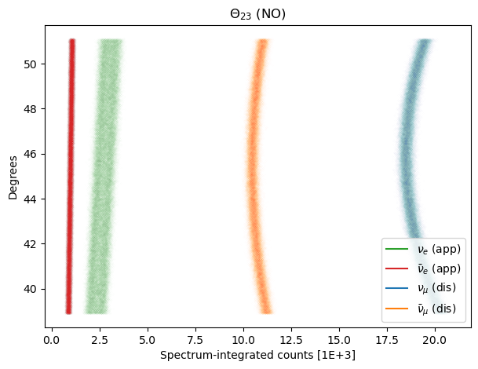
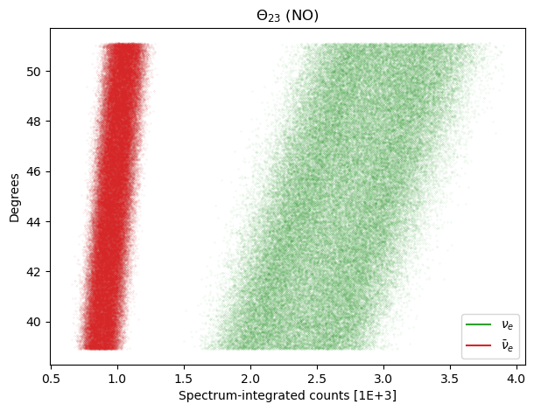
Expect good predictability in θ₂₃ !
No degeneracy in the appearance channels.
Notes:
This figure is the integrated count plot, which means integrating over the the flux spectrum; that is, the consider the total flux.
<ANIME> We can find that there is no degeneracy in the appearance channels. Right plot is the enlarge one.

Slide 13
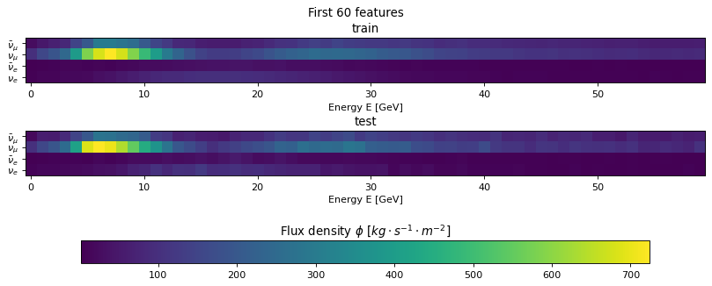
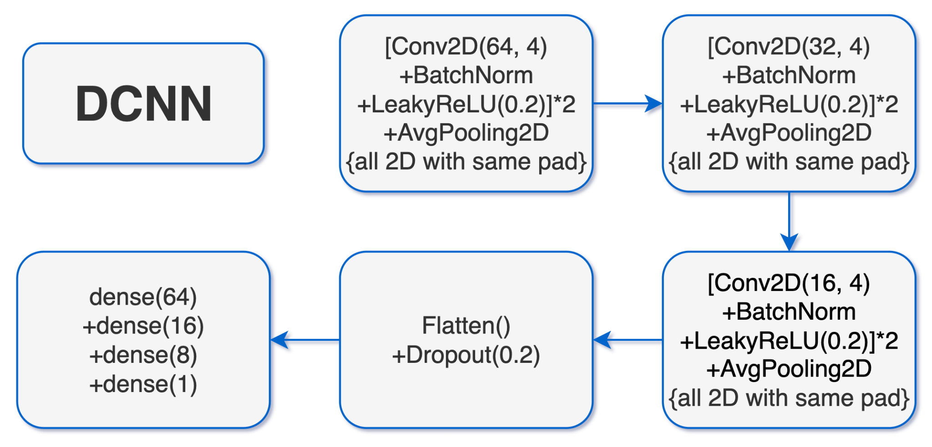
IN: MinMax Normalized
CNN images
+label
θ₂₃
OUT: MinMax Transpose
Loss: huber
Notes:
Here is the procedure of the training model, we input the images with 4 channels times 65 energy bins <POINT>.
Then, we use MinMax normalization to normalize our data within the range 0 to 1.
<ANIME> The model we use is consist of 4 conv2d kernels and 1 small DNN. Like <HERE>, and we use three set of this sort of cells with different filters.
The loss function we use is huber, which combine the characteristics of MSE and MAE.
Conv2D(filter, kernel_size)

Slide 14
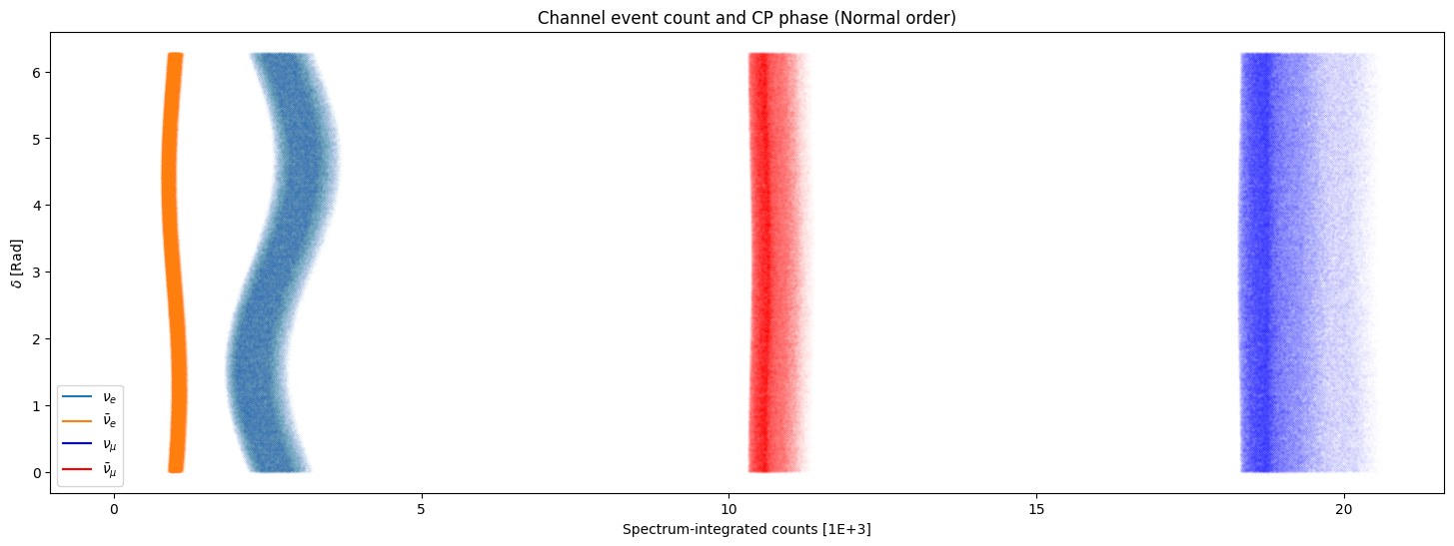
III-A. CNN regression {δ_{CP} }
Theoretically, δ_{CP} relates to:
appearance: ~ cos(𝚫+δ_{CP}) ~ sin δ_{CP}
disappearance: X
In the vacuum oscillation maxima, Δ~90º
N. Nath, M. Ghosh, and S. Goswami, The Physics of Antineutrinos in DUNE and Determination of Octant and δ_{CP}, Nuclear Physics B 913, 381 (2016).
Notes:
Next, we are going to discuss the regression of delta_cp.
Theoretically, the probabilities of appearance and disappearance channels show in here <Here>.
The appearance channel is related to the sin delta_cp; however, there is no direct evidence in disappearance channels.
Regarding the appearance channels, because of the sine relation, it cannot be trivially determined!
Thus, we first use sine to do the regression task; then, do the classification task with arcsine.
(If looking at the whole dataset, it is slightly different among them. <Backup>)
<ANIME (enlarge)>

Slide 15
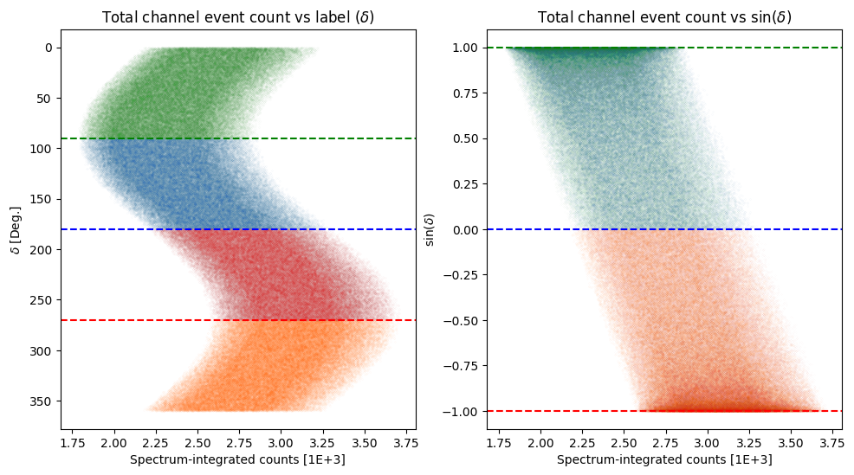
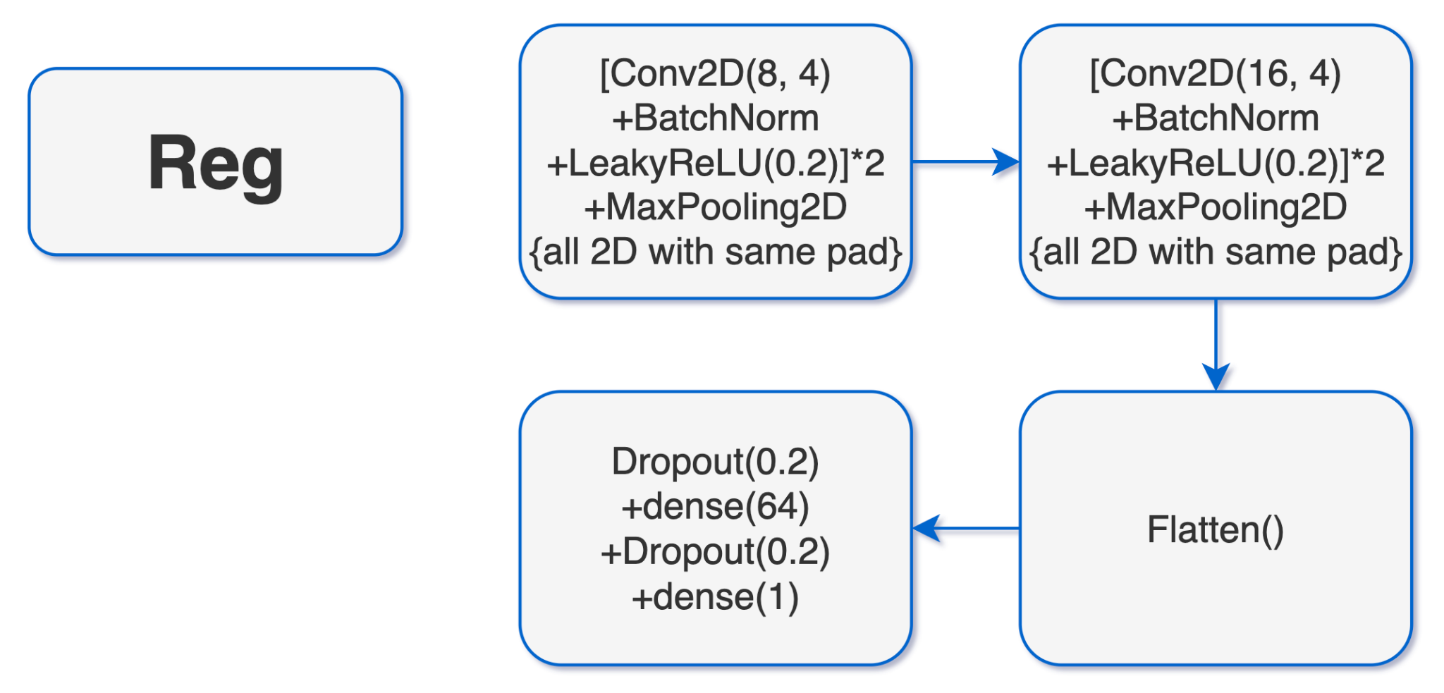
IN: MinMax Normalized
CNN images
sin δ_{CP}
OUT: sine values
Reduce the degeneracy!
Use sine and cosine with 2 transpose arc functions.
Use sine and cosine with tangent and one transpose arc function.
Use one sine and one arc; then, do the classification.
Loss: huber
Notes:
<POINT> This figure is the sine with the degeneracy: “green, blue”, and “red-orange”. If taking the sine of the delta is, it reduces the degeneracy.
We input the MinMax CNN images with dine delta in the regression model <here>.
This model consists of a similar structure to the previous regression model. <model>
Due to the observation of the data, we find that it still has some differences among different phases. So, we believe that it can be classified.
But, on the other hand, you may winder ask why not just use sine and cosine and transpose it implementing 2 arc functions as the features that can easier to get the delta_cp, but in this point of view, we may face two two arc functions, and we know that each arc function may occur a classification bias. So it may cause in difficulty for classification.
Thereby, why not divided sine over cosine? We do not adapt this method is because the denominator may be very small, owing to the domain of cosine, which contains 0 or some number around zero. The defects will result in the overflowing problem. (Inevitably, it will also face one arctan)
So, lastly, we determine to use only one sine function and its arc function; then, do the classification, which we will discuss later.

Slide 16
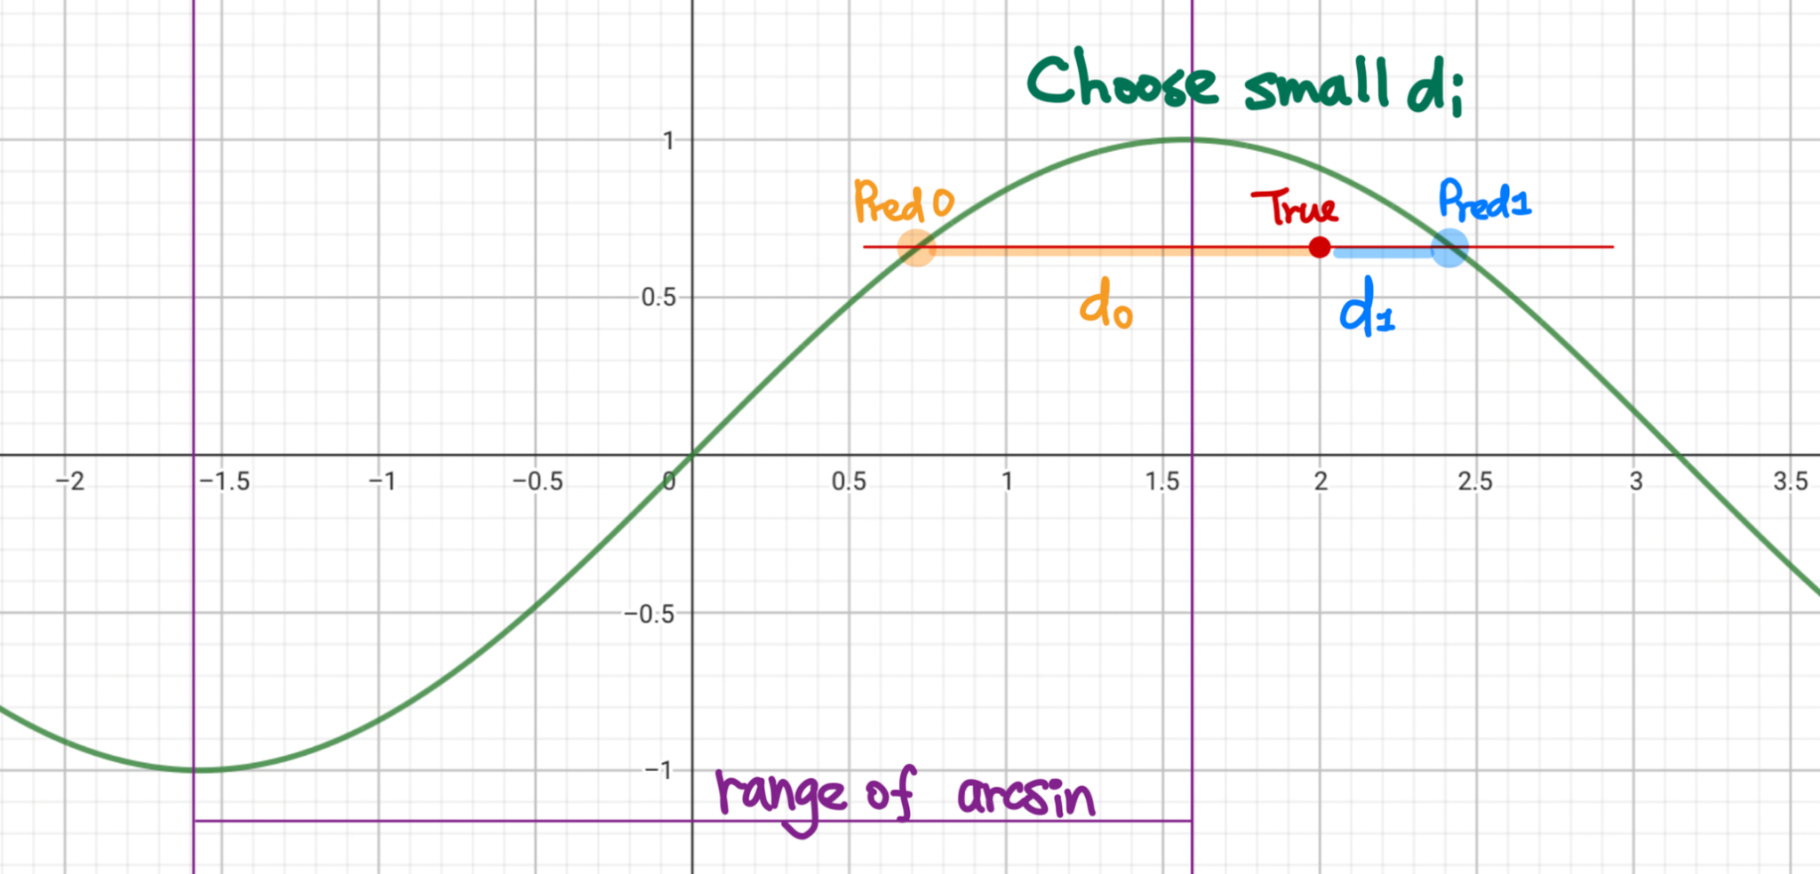
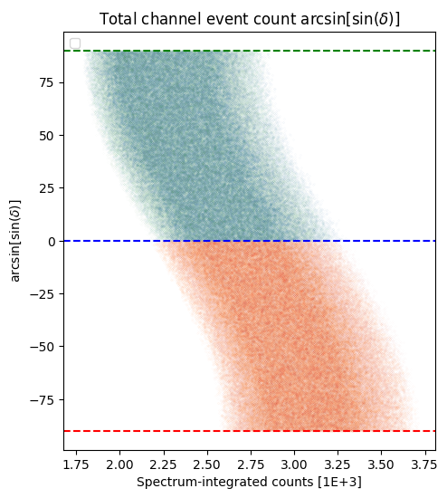
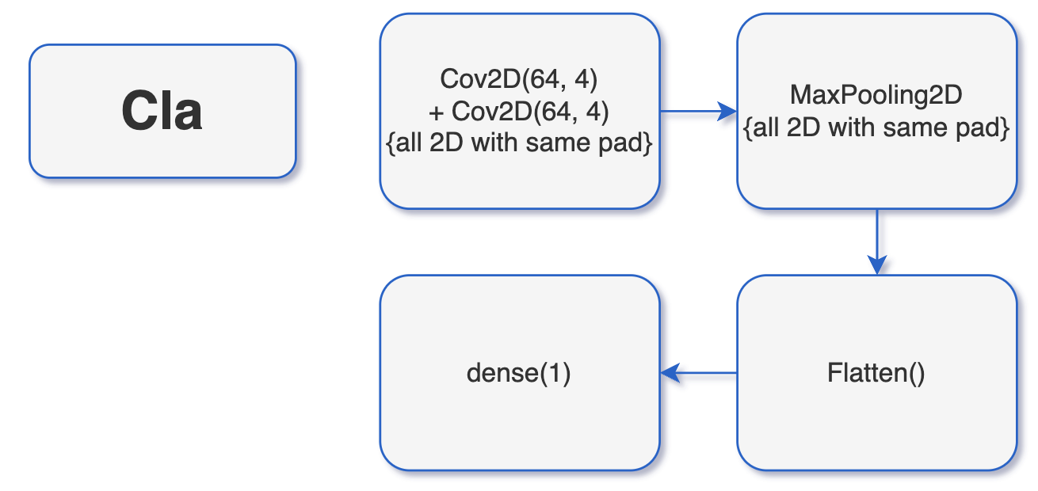
III-B. CNN classification {δ_{CP} }
TRAIN procedure
sin⁻¹(sin δ_{cp})
Give 2 degeneracy δ_{CP}
0
1
Label array with {0,1} +MinMax CNN images
Loss: huber
δ_{CP}
Label
transpose
Notes:
Label_kernel: First, we need to construct the “label kernel”, the input is the sin delta and taking the arc sine of it; then we will get 2 degeneracy delta_cp.
Figure: The green line is the result of the sine. We have known that the domain of arcsine is defined within -pi and pi. So, there is one delta within this range and the other is out of it but still inside the -2pi to 2pi.
Points: The red point represents the true label, in the training step it will be very close to the green sine curve, here i exaggerate it so as to easier to illustrate the labeling method.
Label: The predicted delta with orange color is inside the range of arcsine, I annotated it as 0; the other is blue which is outside the range of arcsine, labeling as 1.
Criteria (d): The criteria of which label number is it depending on the distance between true label and predict label. We will choose the nearest as our predicted output label.
<ANIME>
Model: Therefore, in the heel of constructing the label kernel, we input the normalized CNN images and the label array into the this simple CNN model.
This model made by the two conv2d layer and a max pooling layer.
<ANIME>
Transpose: After that, the output will be the predicted label array and if we want to transform it back to delta_cp, we can use the kernel constructed before. <POINT>

Slide 17
TEST procedure
sin⁻¹(sin δ_{cp})
Give 2 degeneracy δ_{CP}
0
1
MinMax
Normalized
CNN images
Loss: huber
δ_{CP}
Label
transpose
Notes:
The training process is similar, but this time we input the previous predicted sin delta, and take the arcsine of it, and establish the label kernel.
<ANIME>
Input normalized CNN images it will output the label array with 0 and 1.
<ANIME>
Afterward, we can use this label array along with the label kernel to get the delta_cp values.

Slide 18
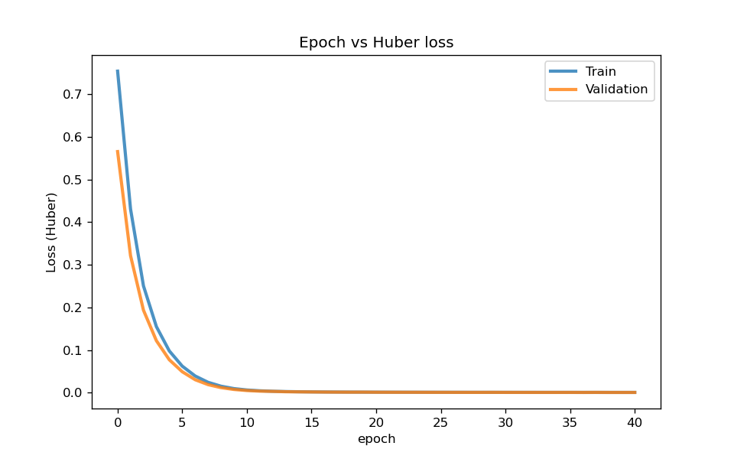
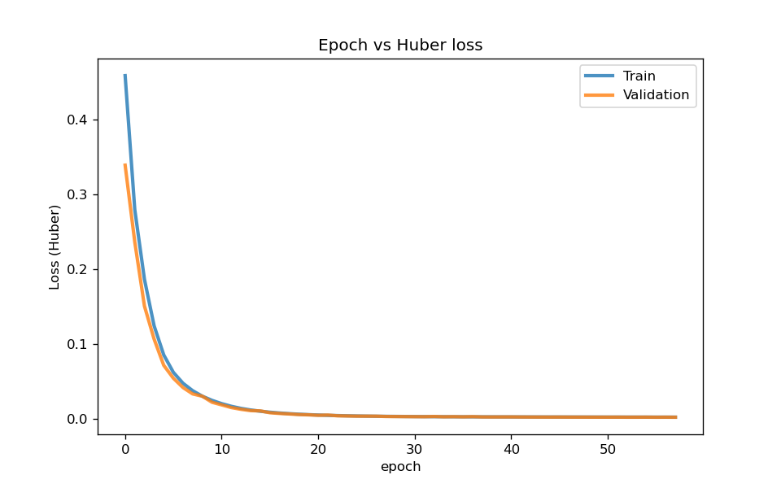
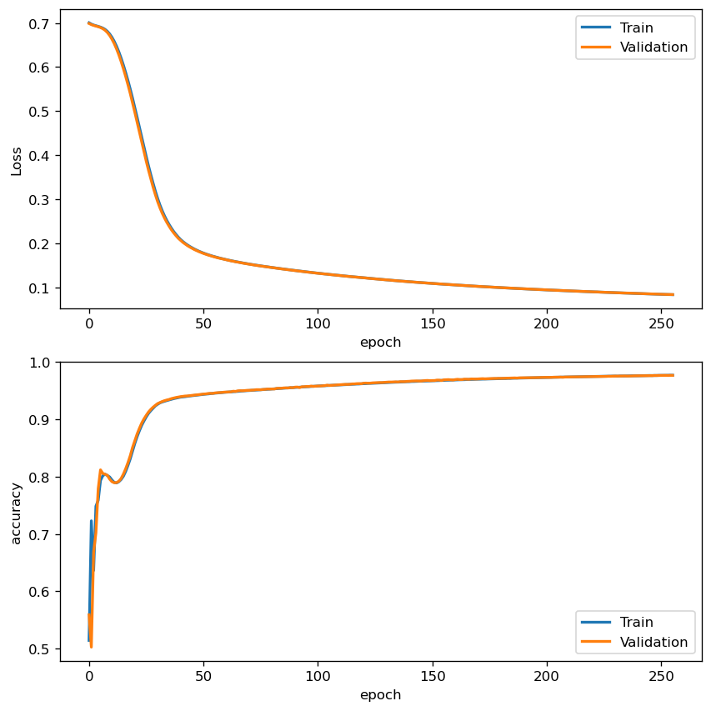
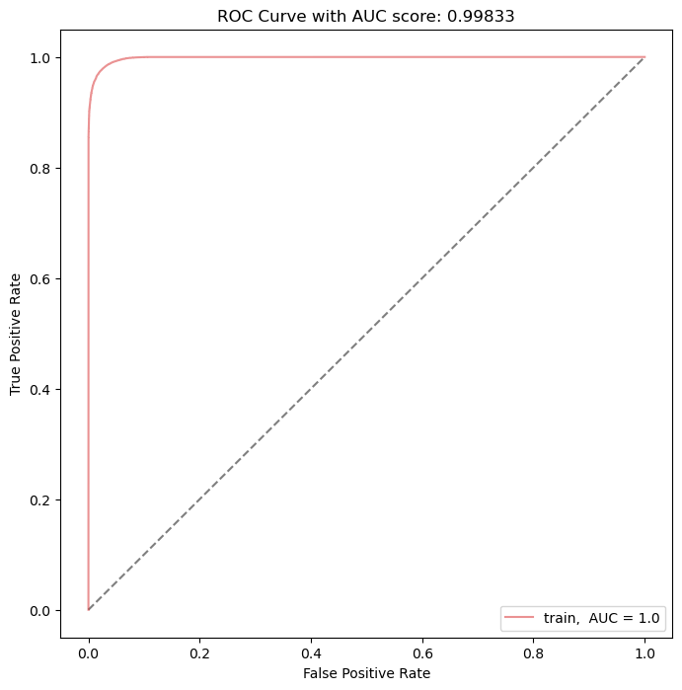
θ₂₃
sin δ_{cp}
δ_{cp}
Training evaluation figures
δ_{cp}
δ_{cp}
Notes:
These figures are the training curves.
<POINT>: Theta regression curve, the origin is the validation line.
…
<POINT>: delta ROC curve with AUC score ~.99 → It seems that is classificate very well.

Slide 19
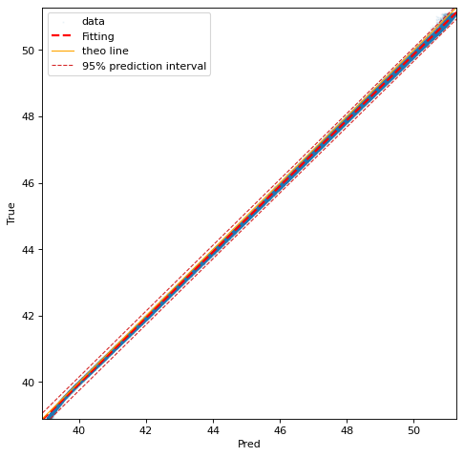
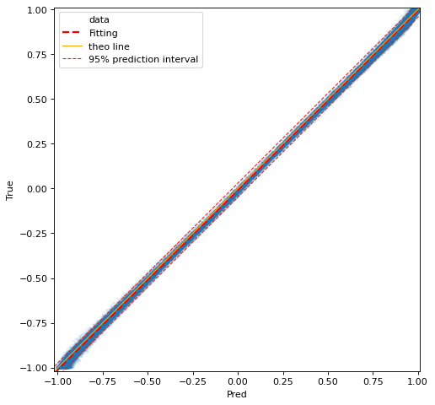
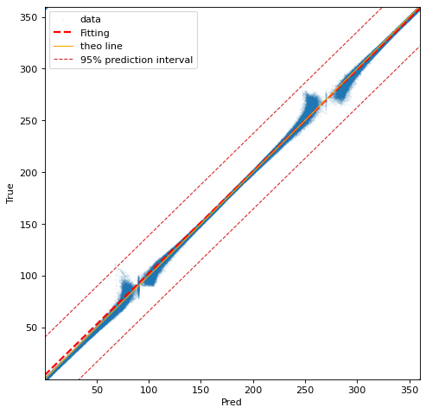
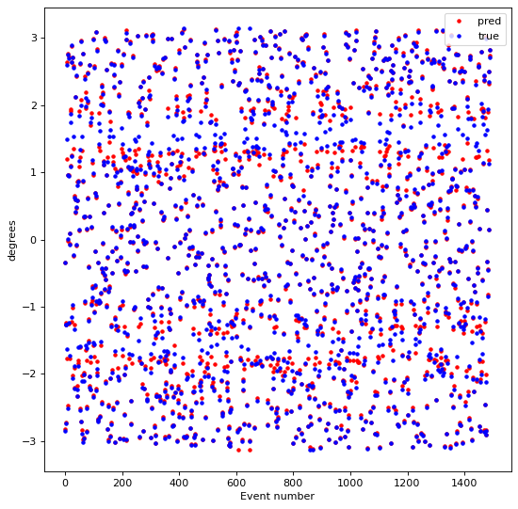
θ₂₃
sin δ_{cp}
δ_{cp}
δ_{cp}
Notes:
Here is the scatter plot using the validation data to predict the result. Y-axis is true label and x axis is the predicted abel.
The regression of Theta_23 and delta_cp fit well.
However, in the delta_cp classification, like what we talk before, there might be some defects on the boundary of the range of arcsine.
These two defect bands can be visualize in this plot <Point>, y-axis is the delta_cp value, x-axis is the number of the event, here i show 1500 events. The red is true labels, and the other blue is the predicted labels.

Slide 20
2.3 Other models
Owing to the overfit with the test sample (base on public and private score), we add noise into the training datasets. Implementing similar models and methods. [improve a little bit]
Due to the arcsine classification distortion, we try to use the models reported in the last presentation. ⇒ Classificate δ_{cp} training data into 4 groups (each group is monotonic); then, do the regression. (reversed procedure of the main δ_{cp} model structure) [do not have obvious improvement]
Notes:
Due to the overfitting of the test data, we apply some noise to the training data. The model is modified DCNN and CNN, and analysis procedure are the same.
Here i show the training plots, the relative significant different is that we can find that the sin delta has obvious fluctuation, but the classification still do the great job base on these figures.

Slide 21
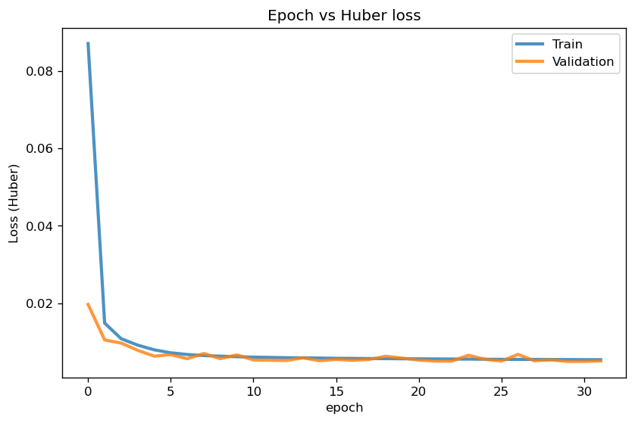

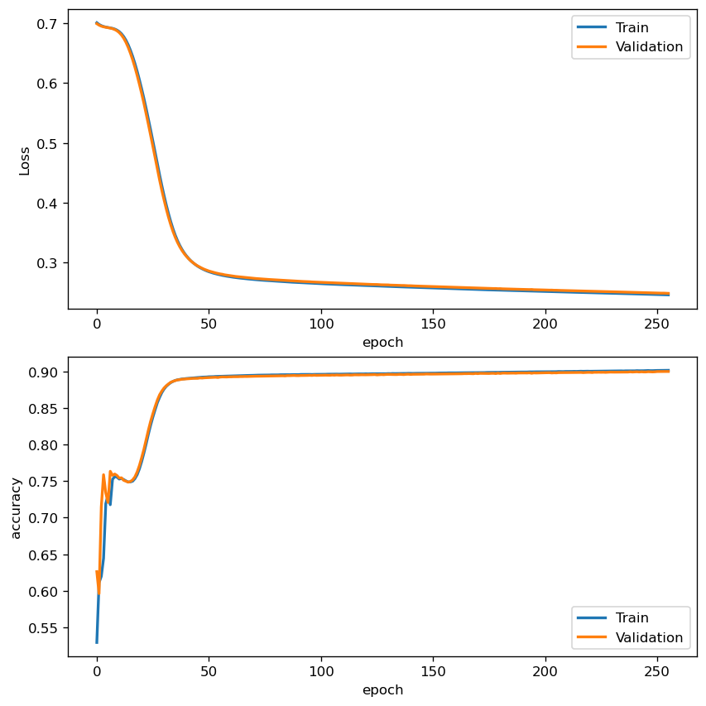
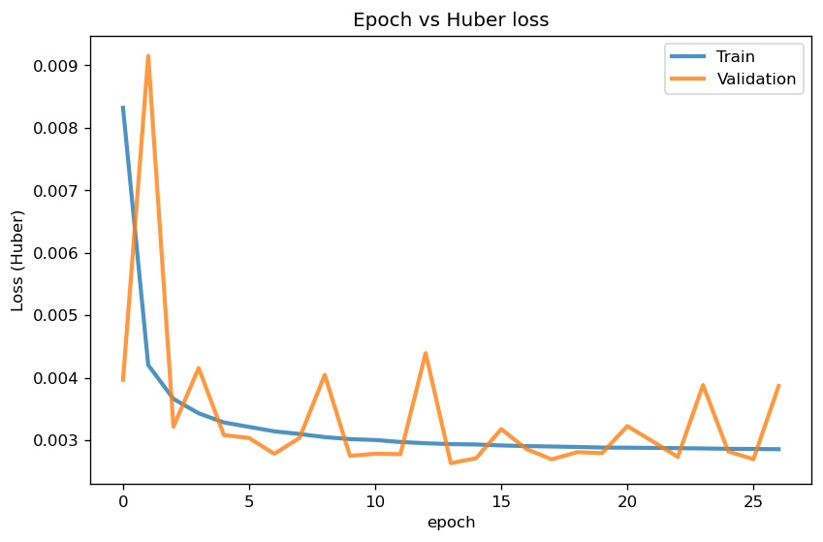
2.3.A Noisy samples
Owing to the overfit with the test sample (base on public and private score), we add noise into the training datasets. Implementing similar models and methods.
θ₂₃
δ_{cp}
sin δ_{cp}
δ_{cp}
δ_{cp}
Notes:
Due to the overfitting of the test data, we apply some noise to the training data. The model is modified DCNN and CNN, and analysis procedure are the same.
Here i show the training plots, the relative significant different is that we can find that the sin delta has obvious fluctuation, but the classification still do the great job base on these figures.

Slide 22
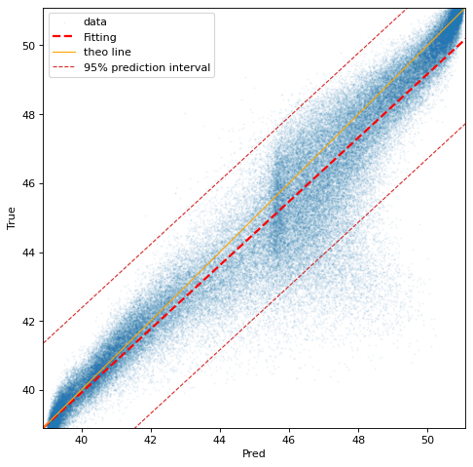
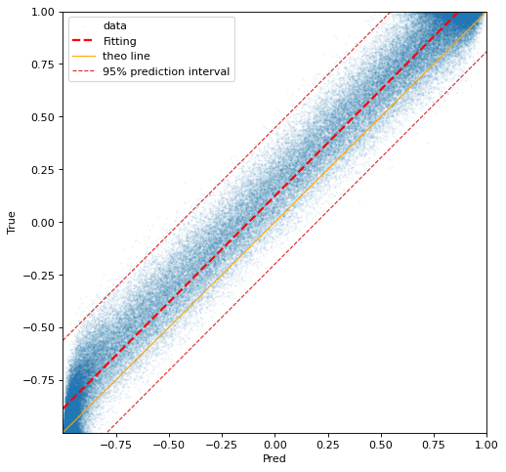
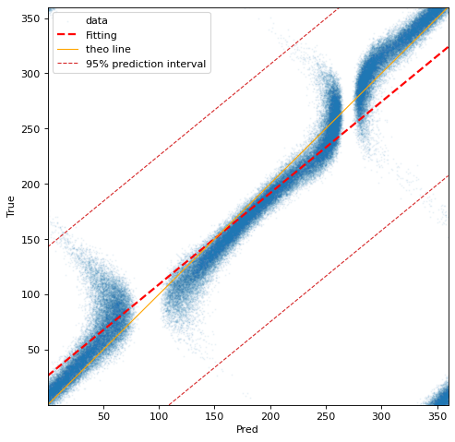
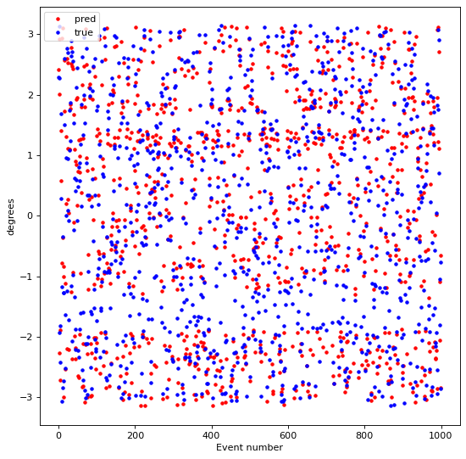
θ₂₃
sin δ_{cp}
δ_{cp}
δ_{cp}
Notes:
However, if looking at the scatter plots, in the view of the Theta_23, around 44 to 50 degrees there are distorted. And in the delta_cp scatter plot <here>, on the boundary of the range of arcsine, it cannot assigned it to the true label, which means near the boundary, this classification cannot do the good jobs. These are the defects that cannot find in the training curves in the previous slide.

Slide 23
2.3.B Reversed δ_{cp} procedure
Due to the arcsine classification distortion, we try to use the models reported in the last presentation.
⇒ Classificate δ_{cp} training data into 4 groups (each group is monocity); then, do the regression. (reversed procedure of the main model structure)
<LOSS CURVE>

Slide 24
時間太長 QQ 放結果就好 <RESULT>

Slide 25
3.1 Summary
Physically, we recap some essential concepts of neutrino oscillation.
For models, we first use the ldm binary model to split data into IO and NO two groups; after that, separating the regression of θ₂₃ and δ_{cp} into several models. θ₂₃: regression; δ_{cp}: sine regression + arcsine classification.
The results fit too well to tolerate the Poisson fluctuations in the test sample.
Apply additional models to rule out the overfitting problems, such as the noisy model and the reversed δ_{cp} procedure model.
Learn from the other group: implement AE to denoise; predict parameters at the same time.

Slide 26
BACK UP

Slide 27
Codes
General backup repo in GitHub: https://github.com/yygarypeng/Neutrino-Oscillation-DUNE
Submission backup in Kaggle: https://www.kaggle.com/competitions/phys591000-2023-final-project-i

Slide 28
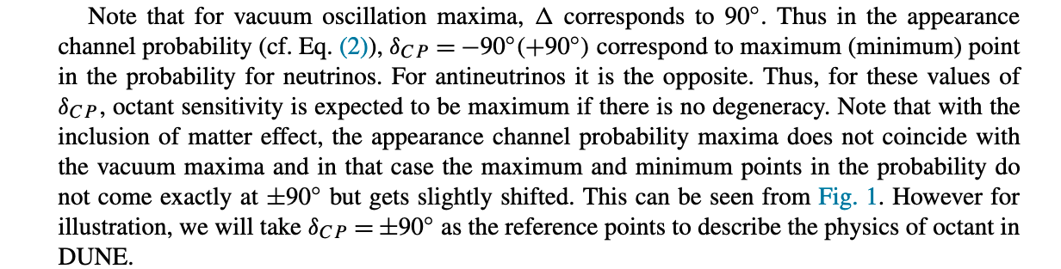
The physics of antineutrinos in DUNE and determination of octant and δ_{CP}
cos(π/2 + δ) = -sin(δ), so this formula is also proportional to sin(δ) if in the vacuum ideal situations. (ref page 386, 387)

Slide 29
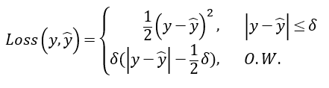
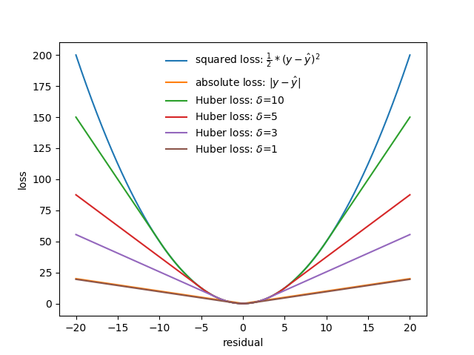
Huber loss
Huber = MSE + MAE
MSE is more sensitive to outliers. ⇒ improve the robustness of the MSE to outliers using MAE.
However, MAE is not stable around the minimum.
Huber loss

Slide 30
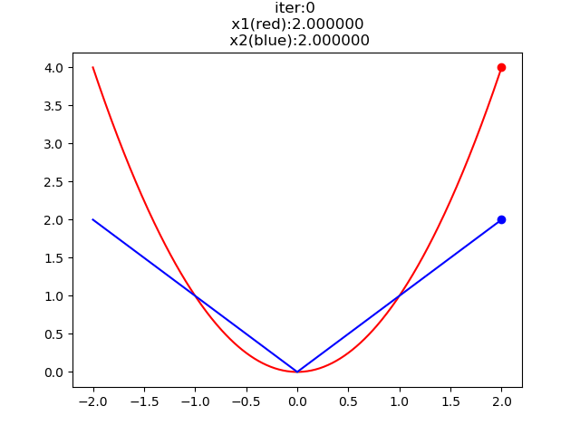
Loss functions MAE vs MSE
Unstable around the local minimum!

Slide 31
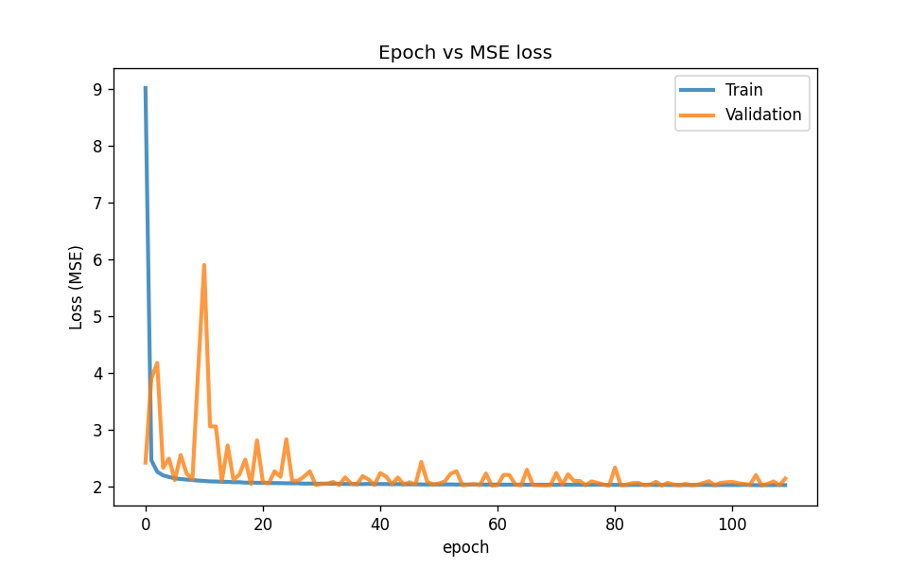
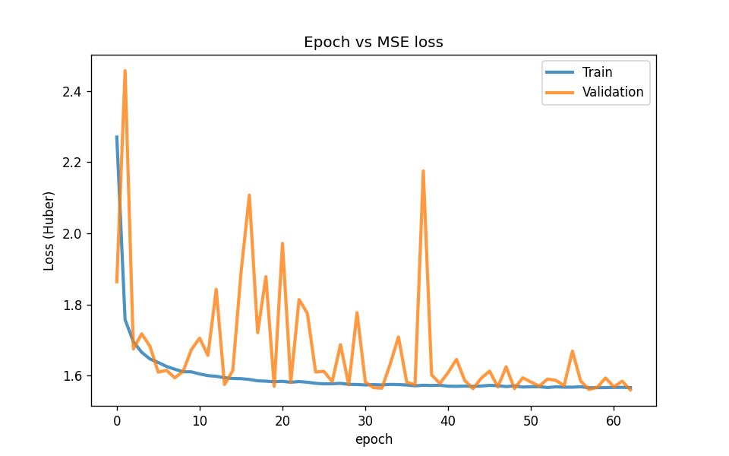
θ₂₃ Loss curves (before normalization)
MSE
Huber
Large fluctuations if no normalization!
Huber loss can zoom out the large loss!

Slide 32

Noisy
figures

Slide 33



Noisy model structures
θ₂₃
δ^{reg}_{cp}
δ^{cla}_{cp}

Slide 34

Test prediction of LDM classification
With noise
Without noise

Slide 35


What is being measured?
The experiment aims to probe the effects of neutrino oscillations and CP violation measurements. Consider the CP asymmetry observable:
In practice, this observable is constructed from the integrated spectrum of decaying leptons N_{ℓ±} and wrong-sign leptons N_{wrongℓ±}

Slide 36

The CP phase and asymmetry observable
As mentioned earlier, the CP phase can be quantified by the level of asymmetry.
Here we present the distribution of CP phase and this observable in both the appearance channel and disappearance channel.

Slide 37


The upper and lower plots present the distribution of CP phase and its relationship with total event counts and the CP asymmetry observable respectively.
Plots of the ν_{e} and ν_{μ} spectrums are on the left and right side respectively.
Our observations show that the event counts in ν_{μ} spectrums are not correlated with the CP phase.

Slide 38

The CP phase Regression
By taking the sine value of the CP phase, we see a clear one-to-one relationship between the asymmetry observable and the sine value.
However, transforming back using the arcsine function will only return values in the interval [-90,90].

Slide 39


Idealized feature space

Slide 40

The CP phase Regression

Slide 41


Slide 42


Slide 43


Slide 44


Slide 45




Sorted four channels with 500 events

Slide 46


The results are sort by the sum of the specific channel.
(In this page, the y-axis is sorted by the sum of “event number ” by ve channel)

Slide 47



Slide 48



Slide 49



Slide 50
© Yuan-Yen Peng and Siang-Yuan Lin, Dept. of Physics, National Tsing Hua, University, Hsinchu, Taiwan.
Email: garyphys0915@gapp.nthu.edu.tw, sylin@gapp.nthu.edu.tw

